Slide 1
Chapter 25
Electric Potential

Slide 2
Electric Potential
Electromagnetism has been connected to the study of forces in previous chapters.
In this chapter, electromagnetism will be linked to energy.
By using an energy approach, problems could be solved that were insoluble using forces.
The concept of potential energy is of great value in the study of electricity.
Because the electrostatic force is conservative, electrostatic phenomena can be conveniently described in terms of an electric potential energy.
This will enable the definition of electric potential.
Introduction

Slide 3


Electrical Potential Energy
When a test charge is placed in an electric field, it experiences a force.
  The force is conservative.
  The electric field will be doing work on the charge. This work is internal to the system.
If the test charge is moved in the field by some external agent, the work done by the field is the negative of the work done by the external agent.
is an infinitesimal displacement vector that is oriented tangent to a path through space.
  The path may be straight or curved and the integral performed along this path is called either a path integral or a line integral.
Section 25.1

Slide 4




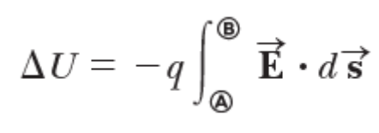
Electric Potential Energy, cont
For an infinitesimal displacement of a point charge q immersed in an electric
field, the work done within the charge–field system by the electric field on the charge is
The internal work done in a system is equal to the negative of the change in the potential energy of the system
Therefore, as the charge q is displaced, the electric potential energy of the charge–field system is changed by an amount
For a finite displacement of the charge from A to B, the change in potential energy of the system is
Because the force is conservative, the line integral does not depend on the path taken by the charge.
Section 25.1
Notes:
Work can be defined as transfer of energy. Work is the application of a force over a distance. Lifting a weight from the ground and putting it on a shelf is a good example of work.
There are two types of energy in many forms:
Kinetic Energy = Energy of Motion
Potential Energy = Stored Energy
Energy can be defined as the capacity for doing work. You must have energy to accomplish work
The change in the kinetic energy of an object is equal to the net work done on the object. This fact is referred to as the Work-Energy Principle and is often a very useful tool in mechanics problem solving.

Slide 5
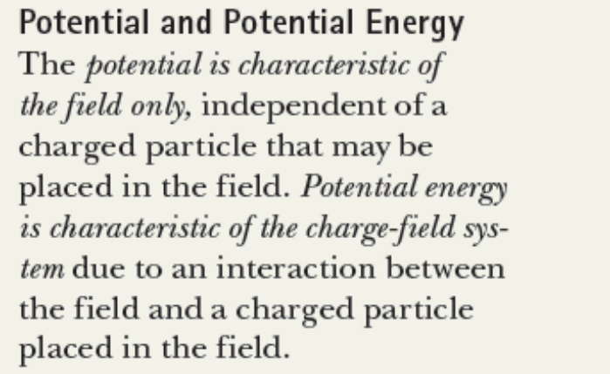
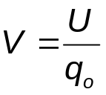
Electric Potential
The potential energy per unit charge, U/q_{o}, is the electric potential.
  The potential is characteristic of the field only.
  The potential energy is characteristic of the charge-field system.
The potential has a value at every point in an electric field and depends only on the source charge distribution.
The electric potential is
The electric potential at any point in an electric field is a scalar quantity.
Section 25.1
Notes:
If you have field, you have potential. You will have potential energy when you place a charge inside that field.

Slide 6
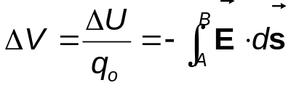
Electric Potential, cont.
The potential is a scalar quantity.
  Since energy is a scalar
As a charged particle moves in an electric field, it will experience a change in potential or a potential difference given by:
The infinitesimal displacement is interpreted as the displacement between two points in space rather than the displacement of a point charge.
Section 25.1

Slide 7
Electric Potential, final
The difference in potential is the meaningful quantity.
We often take the value of the potential to be zero at some convenient point in the field.
Electric potential is a scalar characteristic of an electric field, independent of any charges that may be placed in the field.
The potential difference between two points exists solely because of a source charge and depends on the source charge distribution.
  For a potential energy to exist, there must be a system of two or more charges.
  The potential energy belongs to the system and changes only if a charge is moved relative to the rest of the system.
Section 25.1
Notes:
The potential difference between A and B exists solely because of a source
charge and depends on the source charge distribution (consider points A and
B in the discussion above without the presence of the charge q). For a potential
energy to exist, we must have a system of two or more charges. The potential energy belongs to the system and changes only if a charge is moved relative to
the rest of the system. This situation is similar to that for the electric field. An
electric field exists solely because of a source charge. An electric force requires two
charges: the source charge to set up the field and another charge placed within
that field.

Slide 8
Work and Electric Potential
Assume a charge moves in an electric field without any change in its kinetic energy.
The work performed on the charge is
  W = ΔU = q ΔV
Units:1 V ≡ 1 J/C
  V is a volt.
  It takes one joule of work to move a 1-coulomb charge through a potential difference of 1 volt.
In addition, 1 N/C = 1 V/m
  This indicates we can interpret the electric field as a measure of the rate of change of the electric potential with respect to position.
Electric potential is a measure of potential energy per unit charge
Section 25.1

Slide 9
Voltage
Electric potential is described by many terms.
The most common term is voltage.
A voltage applied to a device or across a device is the same as the potential difference across the device.
  The voltage is not something that moves through a device.
Section 25.1

Slide 10
Electron-Volts
Another unit of energy that is commonly used in atomic and nuclear physics is the electron-volt.
One electron-volt is defined as the energy a charge-field system gains or loses when a charge of magnitude e (an electron or a proton) is moved through a potential difference of 1 volt.
  1 eV = 1.60 x 10⁻¹⁹ J
Section 25.1

Slide 11

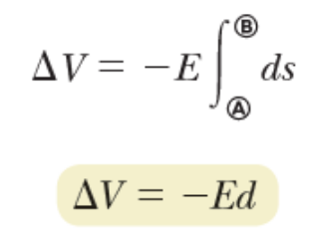
Potential Difference in a Uniform Field
The equations for electric potential between two points A and B can be simplified if the electric field is uniform:
The displacement points from A to B and is parallel to the field lines.
The negative sign indicates that the electric potential at point B is lower than at point A.
  Electric field lines always point in the direction of decreasing electric potential.
Section 25.2

Slide 12
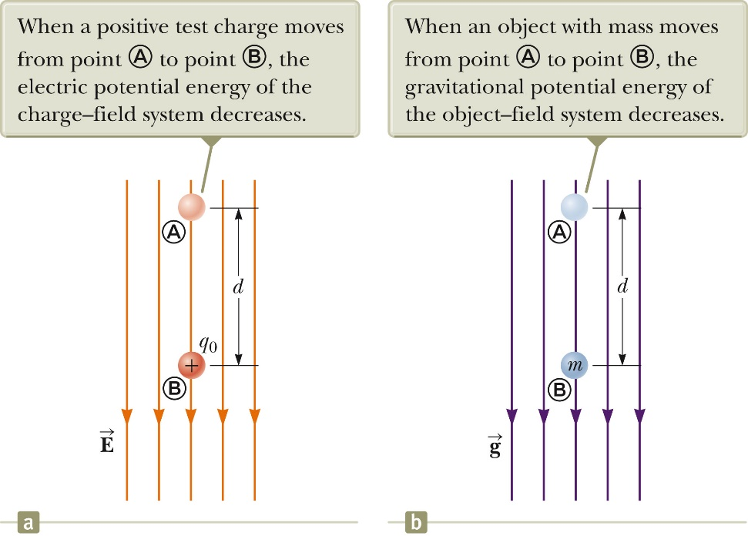
Energy and the Direction of Electric Field
When the electric field is directed downward, point B is at a lower potential than point A.
When a positive test charge moves from A to B, the charge-field system loses potential energy.
Electric field lines always point in the direction of decreasing electric potential.
Section 25.2

Slide 13
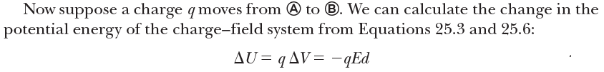
More About Directions
A system consisting of a positive charge and an electric field loses electric potential energy when the charge moves in the direction of the field.
  An electric field does work on a positive charge when the charge moves in the direction of the electric field.
The charged particle gains kinetic energy and the potential energy of the charge-field system decreases by an equal amount.
  Another example of Conservation of Energy
Section 25.2
Notes:
This result shows that if q is positive, then DU is negative. Therefore, in a system
consisting of a positive charge and an electric field, the electric potential energy
of the system decreases when the charge moves in the direction of the field. If a
positive charge is released from rest in this electric field, it experiences an electric
force qE S
in the direction of E
S
(downward in Fig. 25.2a). Therefore, it accelerates
downward, gaining kinetic energy. As the charged particle gains kinetic energy, the
electric potential energy of the charge–field system decreases by an equal amount.
This equivalence should not be surprising; it is simply conservation of mechanical
energy in an isolated system as introduced in Chapter 8.
A system consisting of a negative charge and an electric field gains electric potential
energy when the charge moves in the direction of the field. If a negative charge is
released from rest in an electric field, it accelerates in a direction opposite the direction
of the field. For the negative charge to move in the direction of the field, an
external agent must apply a force and do positive work on the charge.

Slide 14
Directions, cont.
If q_{o} is negative, then ΔU is positive.
A system consisting of a negative charge and an electric field gains potential energy when the charge moves in the direction of the field.
  In order for a negative charge to move in the direction of the field, an external agent must do positive work on the charge.
Section 25.2

Slide 15
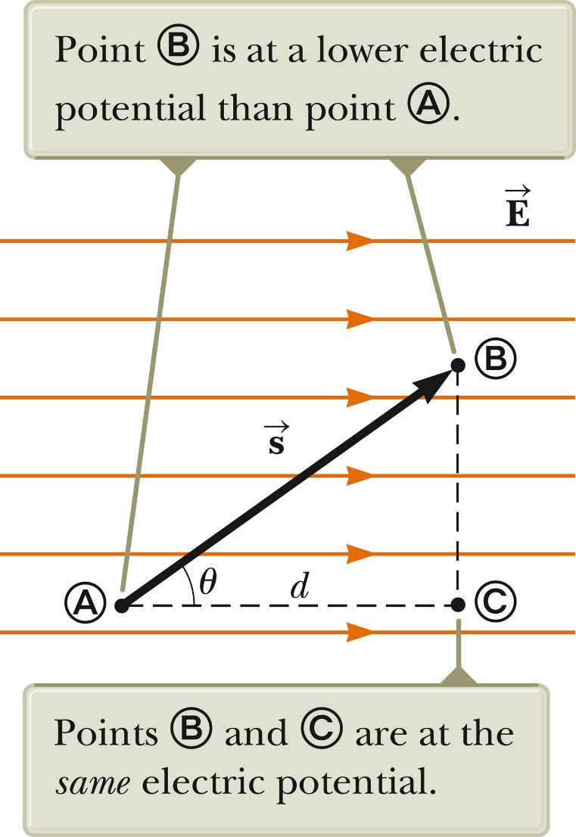
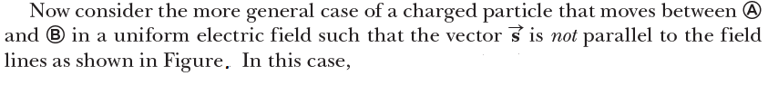
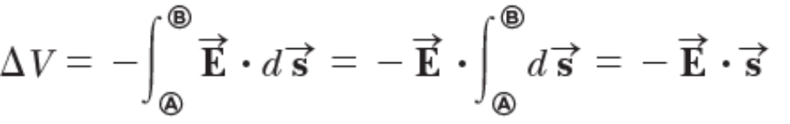

Equipotentials
Point B is at a lower potential than point A.
Points B and C are at the same potential.
  All points in a plane perpendicular to a uniform electric field are at the same electric potential.
The name equipotential surface is given to any surface consisting of a continuous distribution of points having the same electric potential.
Section 25.2

Slide 16
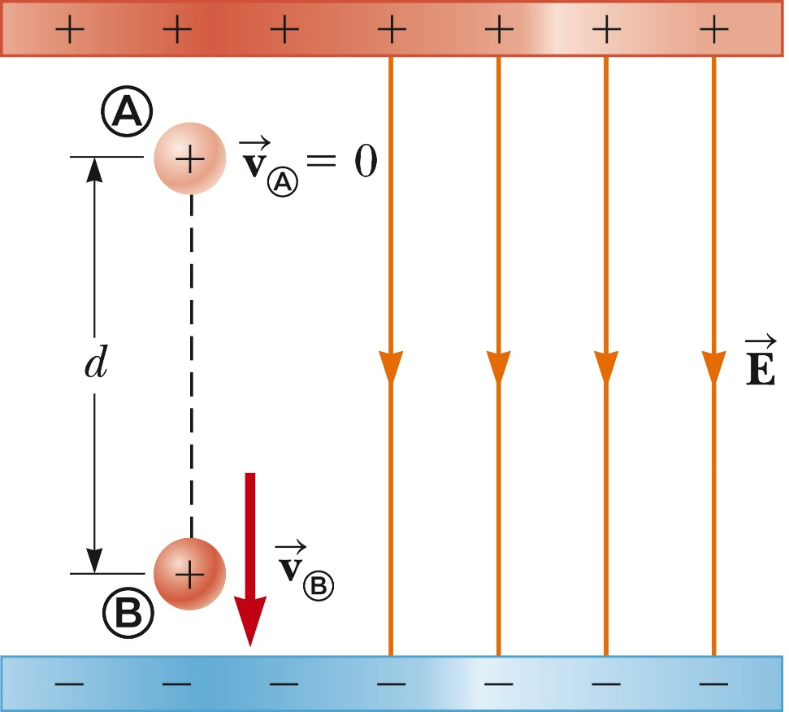
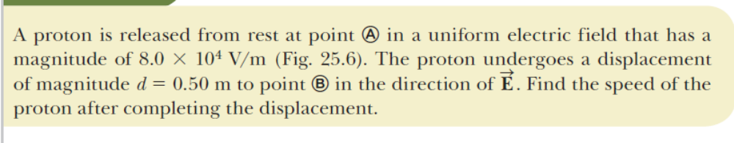
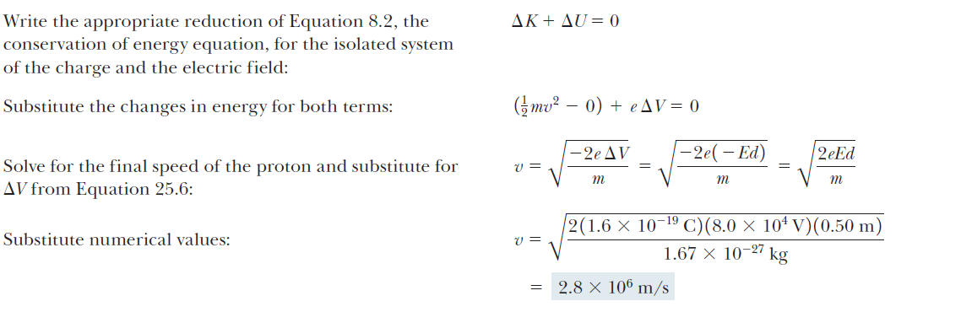
Charged Particle in a Uniform Field, Example
Section 25.2

Slide 17
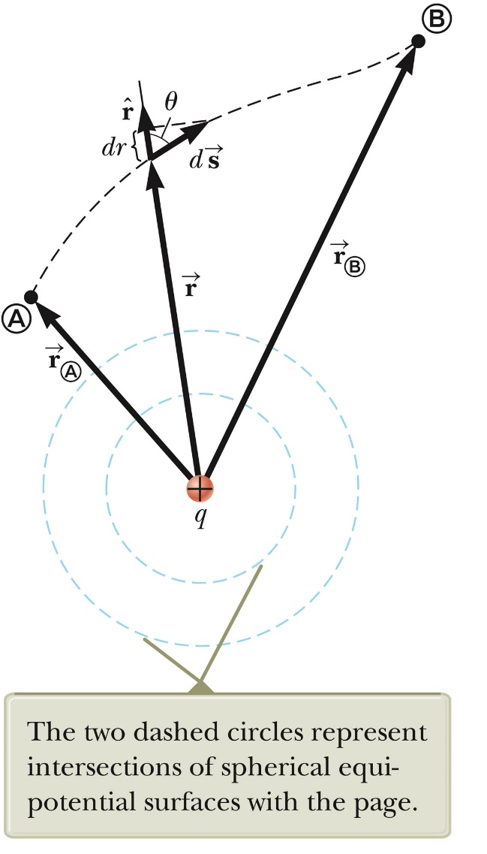
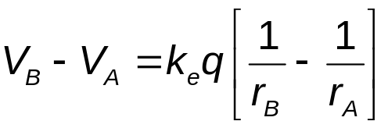
Potential and Point Charges
An isolated positive point charge produces a field directed radially outward.
The potential difference between points A and B will be
Section 25.3

Slide 18
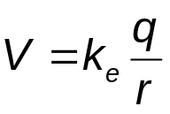
Potential and Point Charges, cont.
The electric potential is independent of the path between points A and B.
It is customary to choose a reference potential of V = 0 at r_{A} = ∞.
Then the potential due to a point charge at some point r is
Section 25.3
Notes:
By looking at the formula in the previous slide, we set rA = 0, then 1/rA goes to zero and we obtain the formula in this slide.

Slide 19
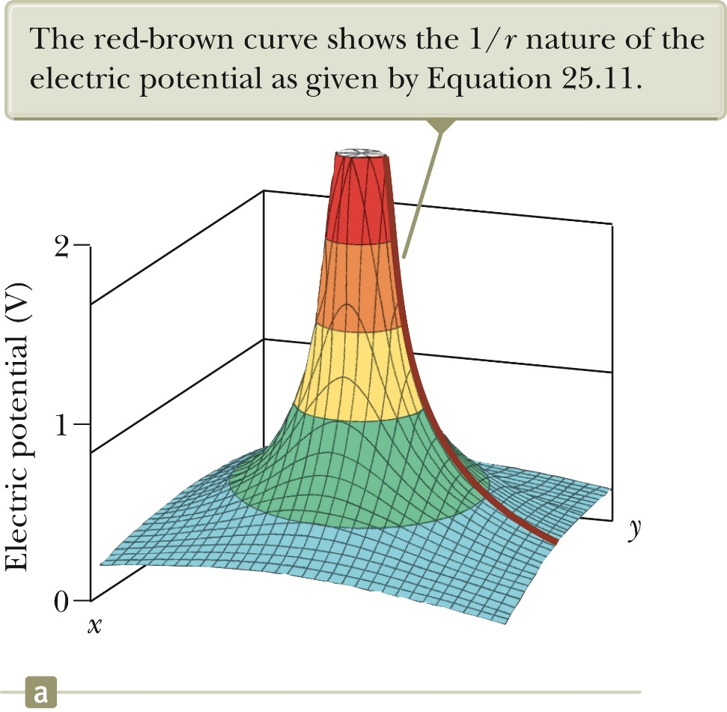
Electric Potential of a Point Charge
The electric potential in the plane around a single point charge is shown.
The red line shows the 1/r nature of the potential.
Section 25.3

Slide 20
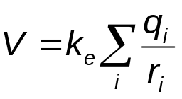
Electric Potential with Multiple Charges
The electric potential due to several point charges is the sum of the potentials due to each individual charge.
  This is another example of the superposition principle.
  The sum is the algebraic sum
    V = 0 at r = ∞
Section 25.3

Slide 21
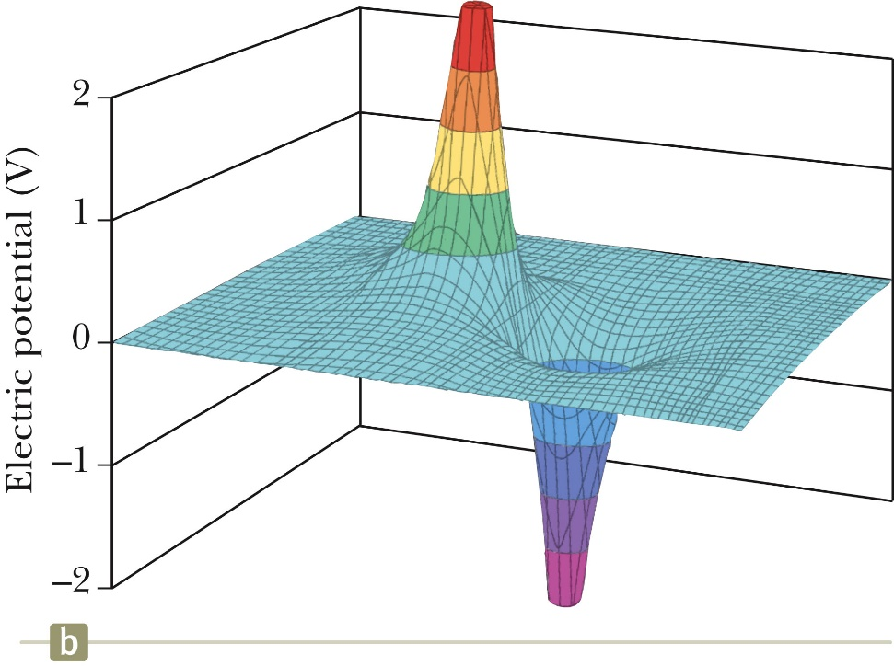
Electric Potential of a Dipole
The graph shows the potential (y-axis) of an electric dipole.
The steep slope between the charges represents the strong electric field in this region.
PHYS143 – Spring 2017 – © O. Al Khatib
Section 25.3

Slide 22
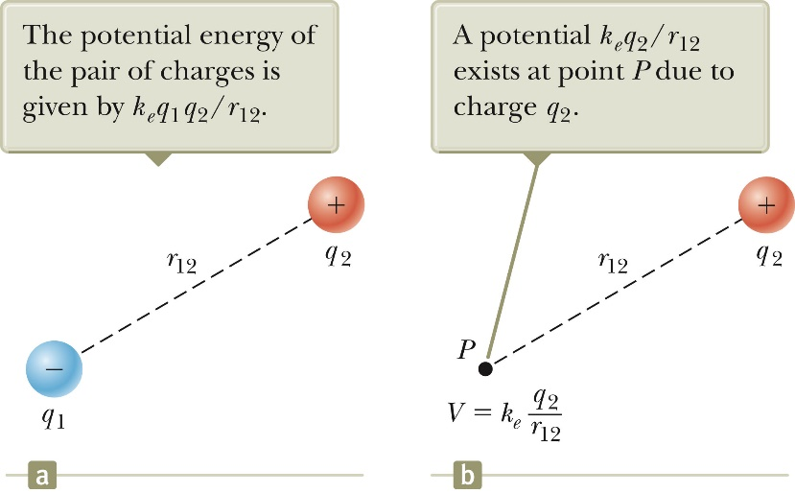
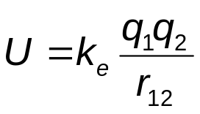
Potential Energy of Multiple Charges
The potential energy of the system is .
If the two charges are the same sign, U is positive and work must be done to bring the charges together.
If the two charges have opposite signs, U is negative and work is done to keep the charges apart.
Section 25.3

Slide 23
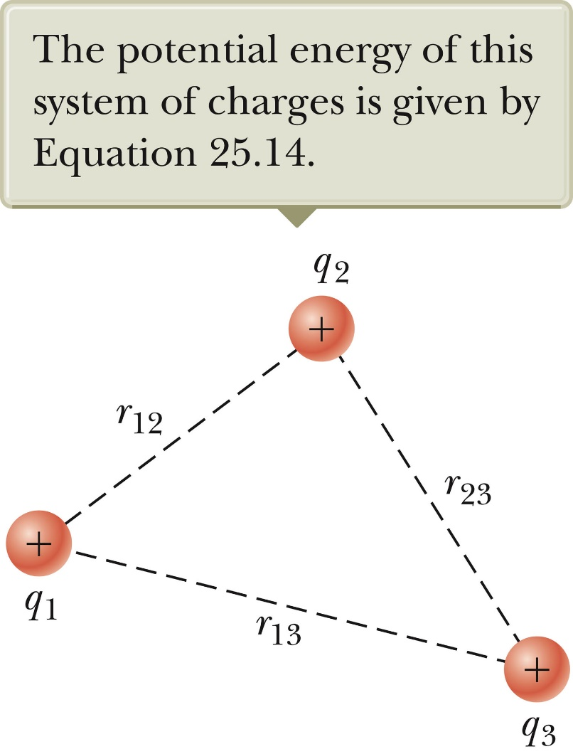
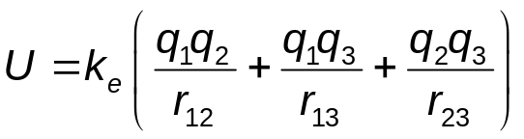
U with Multiple Charges, final
If there are more than two charges, then find U for each pair of charges and add them.
For three charges:
  The result is independent of the order of the charges.
PHYS143 – Spring 2017 – © O. Al Khatib
Section 25.3

Slide 24
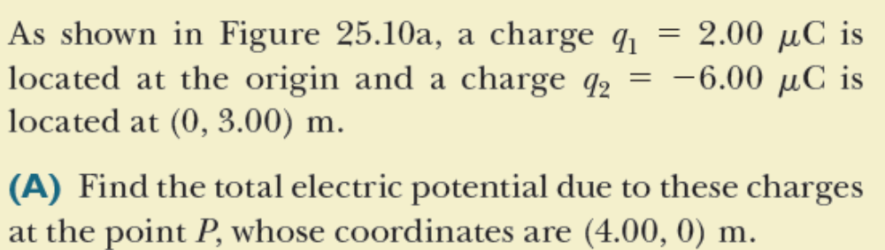
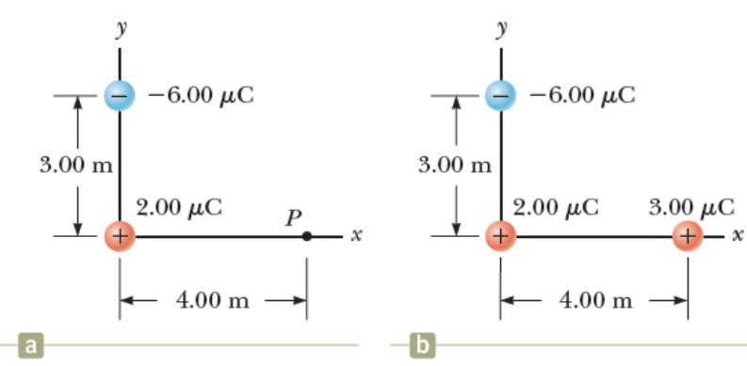
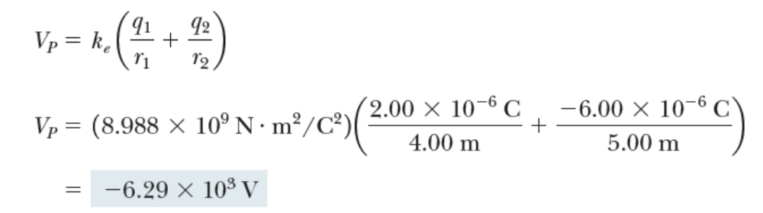
The Electric Potential Due to Two Point Charges, Example
Section 25.4

Slide 25


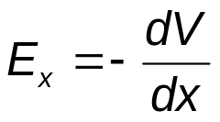
Finding E From V
Assume, to start, that the field has only an x component. Then,
Therefore,
That is, the x component of the electric field is equal to the negative of the derivative of the electric potential with respect to x.
Similar statements would apply to the y and z components.
Equipotential surfaces must always be perpendicular to the electric field lines passing through them.
Section 25.4

Slide 26
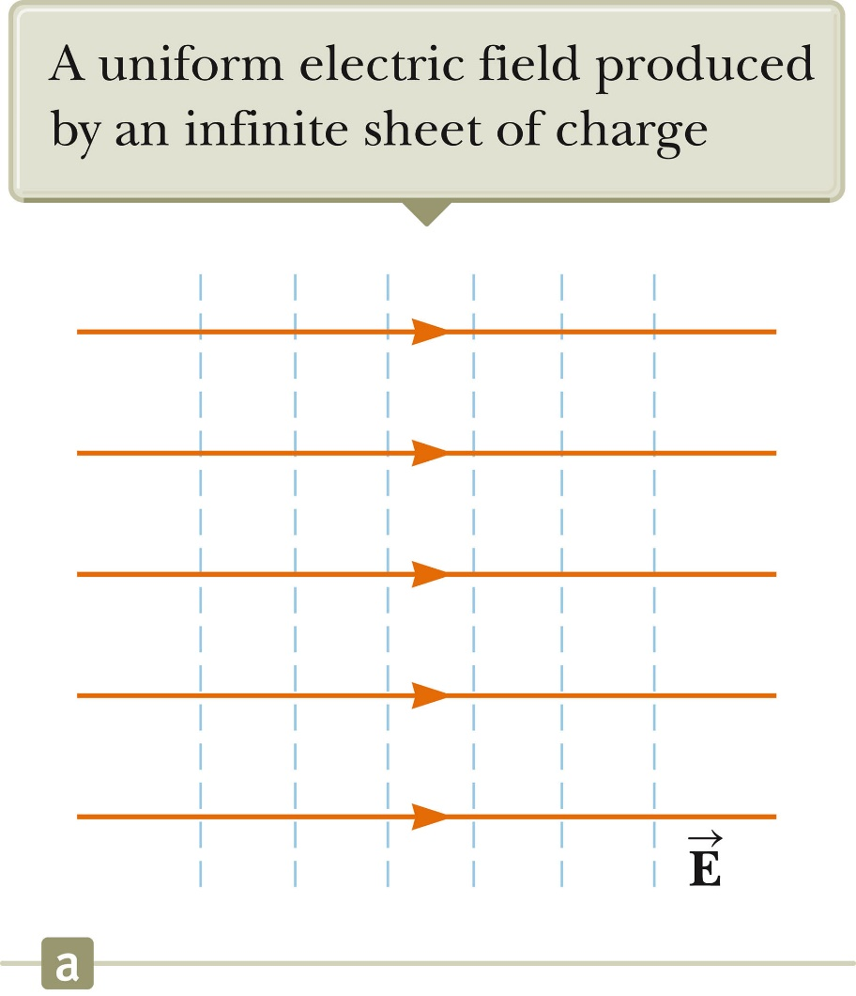
E and V for an Infinite Sheet of Charge
The equipotential lines are the dashed blue lines.
The electric field lines are the brown lines.
The equipotential lines are everywhere perpendicular to the field lines.
PHYS143 – Spring 2017 – © O. Al Khatib
Section 25.4

Slide 27
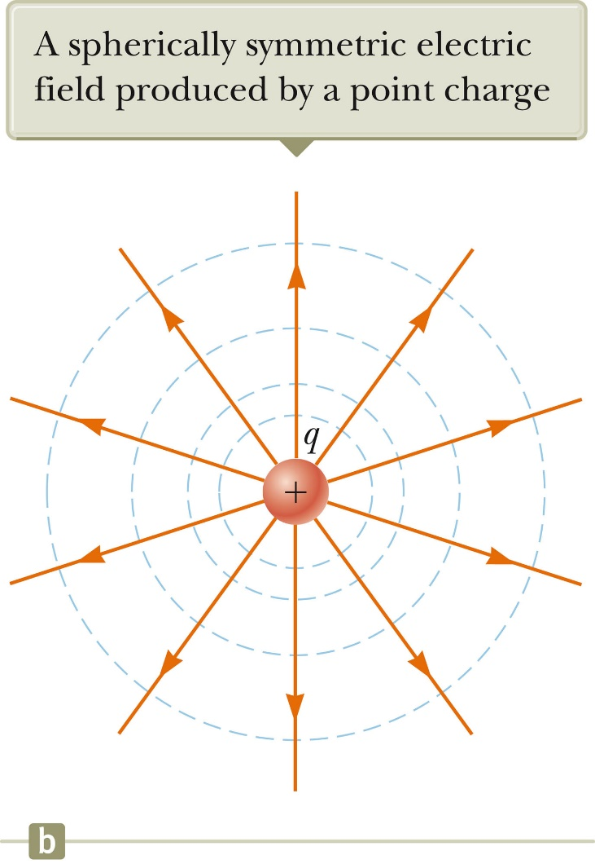
E and V for a Point Charge
The equipotential lines are the dashed blue lines.
The electric field lines are the brown lines.
The electric field is radial.
E_{r} = - dV / dr
The equipotential lines are everywhere perpendicular to the field lines.
PHYS143 – Spring 2017 – © O. Al Khatib
Section 25.4

Slide 28
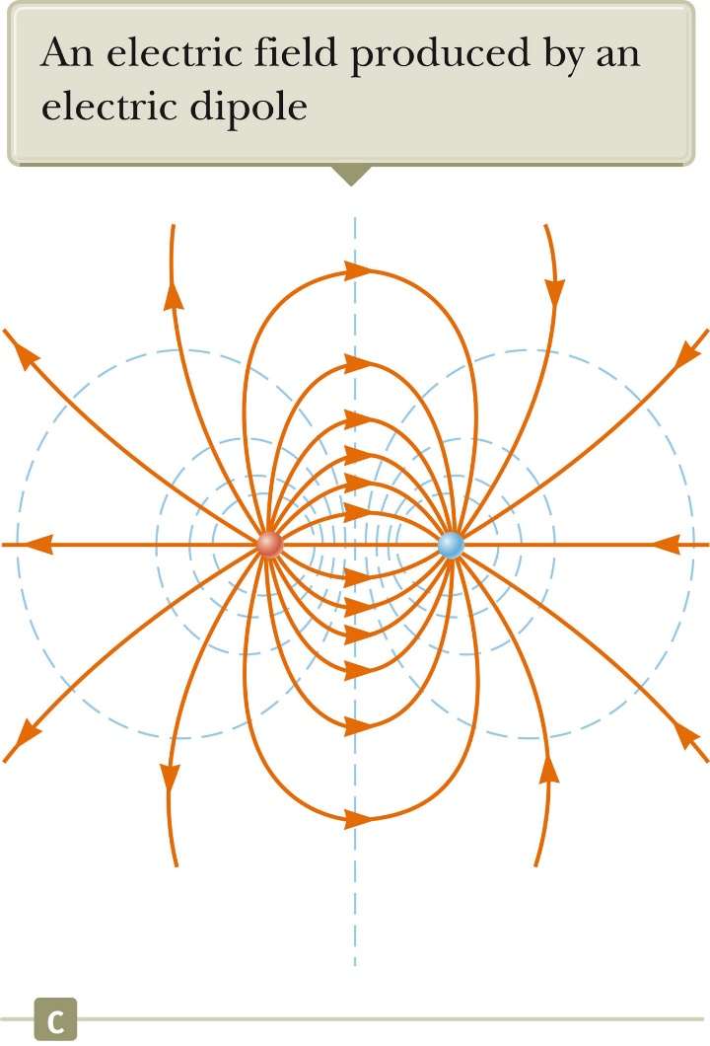
E and V for a Dipole
The equipotential lines are the dashed blue lines.
The electric field lines are the brown lines.
The equipotential lines are everywhere perpendicular to the field lines.
PHYS143 – Spring 2017 – © O. Al Khatib
Section 25.4

Slide 29
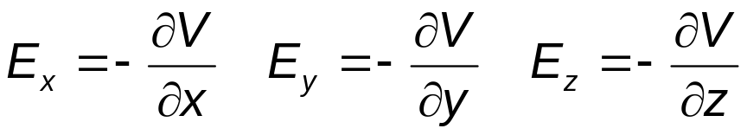
Electric Field from Potential, General
In general, the electric potential is a function of all three dimensions.
Given V (x, y, z) you can find E_{x}, E_{y} and E_{z} as partial derivatives:
Section 25.4

Slide 30
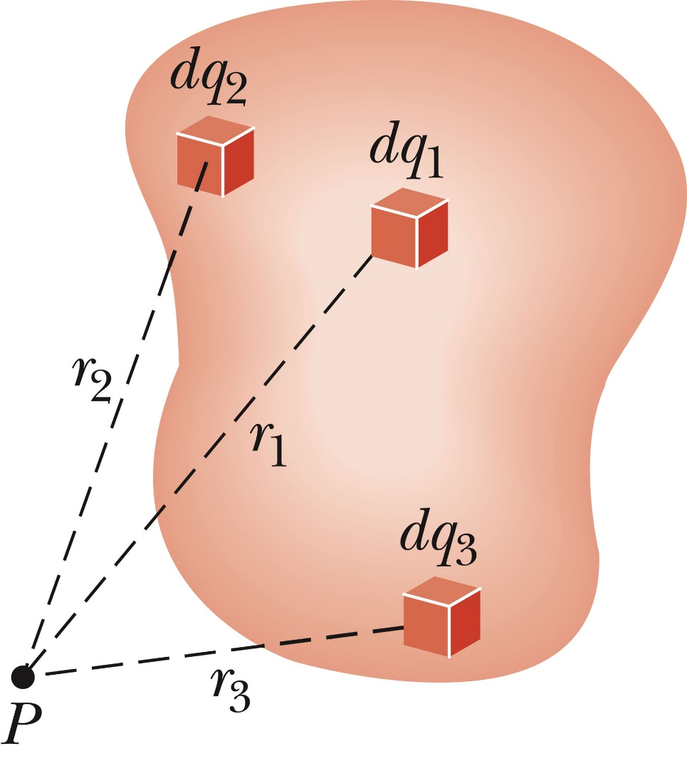
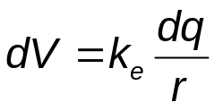
Electric Potential for a Continuous Charge Distribution
Method 1: The charge distribution is known.
Consider a small charge element dq
  Treat it as a point charge.
The potential at some point due to this charge element is
Section 25.5

Slide 31
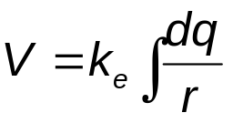
V for a Continuous Charge Distribution, cont.
To find the total potential, you need to integrate to include the contributions from all the elements.
  This value for V uses the reference of V = 0 when P is infinitely far away from the charge distributions.

Slide 32
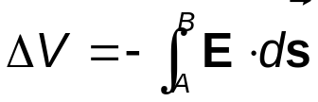
V for a Continuous Charge Distribution, final
Method 2: If the electric field is already known from other considerations such as Gauss’s Law, the potential can be calculated using the original approach:
  If the charge distribution has sufficient symmetry, first find the field from Gauss’ Law and then find the potential difference between any two points,
    Choose V = 0 at some convenient point
Section 25.5

Slide 33
Problem-Solving Strategies
Conceptualize
  Think about the individual charges or the charge distribution.
  Imagine the type of potential that would be created.
  Appeal to any symmetry in the arrangement of the charges.
Categorize
  Group of individual charges or a continuous distribution?
  The answer will determine the procedure to follow in the analysis step.
Section 25.5

Slide 34
Problem-Solving Strategies, 2
Analyze
  General
    Scalar quantity, so no components
    Use algebraic sum in the superposition principle
      Keep track of signs
    Only changes in electric potential are significant
    Define V = 0 at a point infinitely far away from the charges.
      If the charge distribution extends to infinity, then choose some other arbitrary point as a reference point.
Section 25.5

Slide 35
Problem-Solving Strategies, 3
Analyze, cont
  If a group of individual charges is given
    Use the superposition principle and the algebraic sum.
  If a continuous charge distribution is given
    Use integrals for evaluating the total potential at some point.
    Each element of the charge distribution is treated as a point charge.
  If the electric field is given
    Start with the definition of the electric potential.
    Find the field from Gauss’ Law (or some other process) if needed.
Section 25.5

Slide 36
Problem-Solving Strategies, final
Finalize
  Check to see if the expression for the electric potential is consistent with your mental representation.
  Does the final expression reflect any symmetry?
  Image varying parameters to see if the mathematical results change in a reasonable way.
Section 25.5

Slide 37
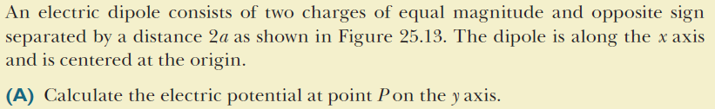
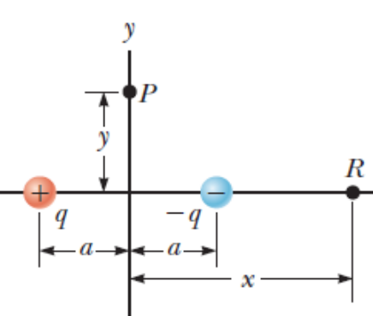


The Electric Potential Due to a Dipole, Example
PHYS143 – Spring 2017 – © O. Al Khatib
Section 25.5

Slide 38
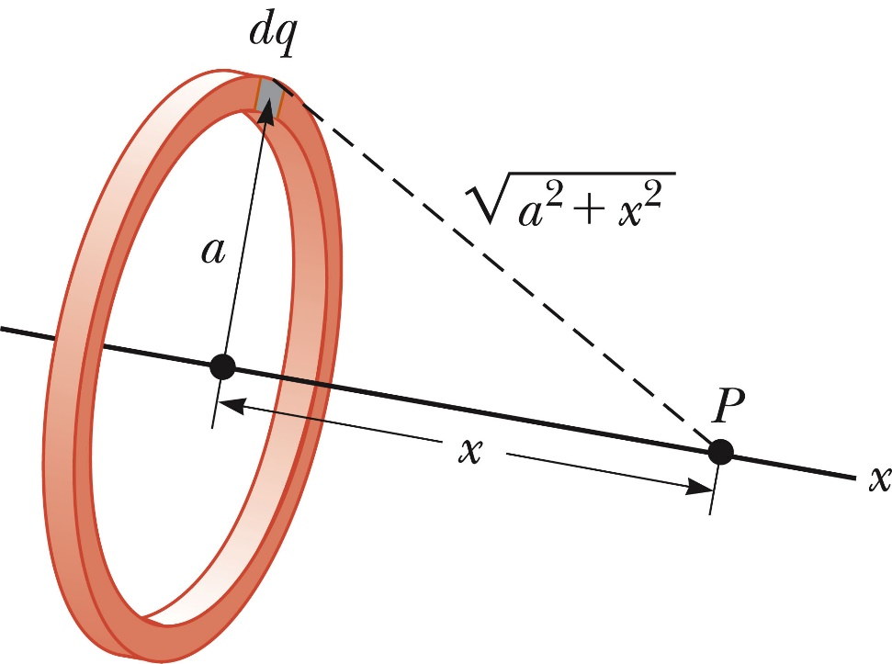
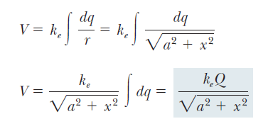
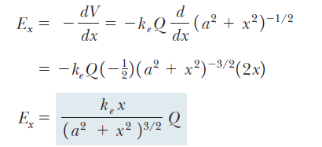
Electric Potential Due to a Uniformly Charged Ring, Example
PHYS143 – Spring 2017 – © O. Al Khatib
Section 25.5

Slide 39
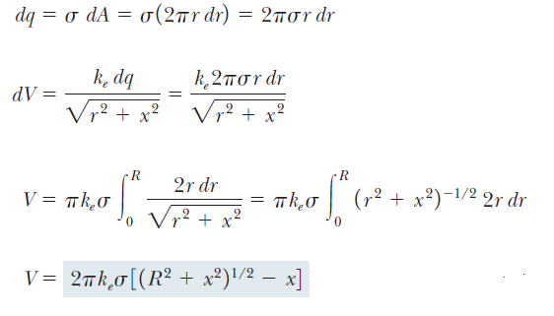
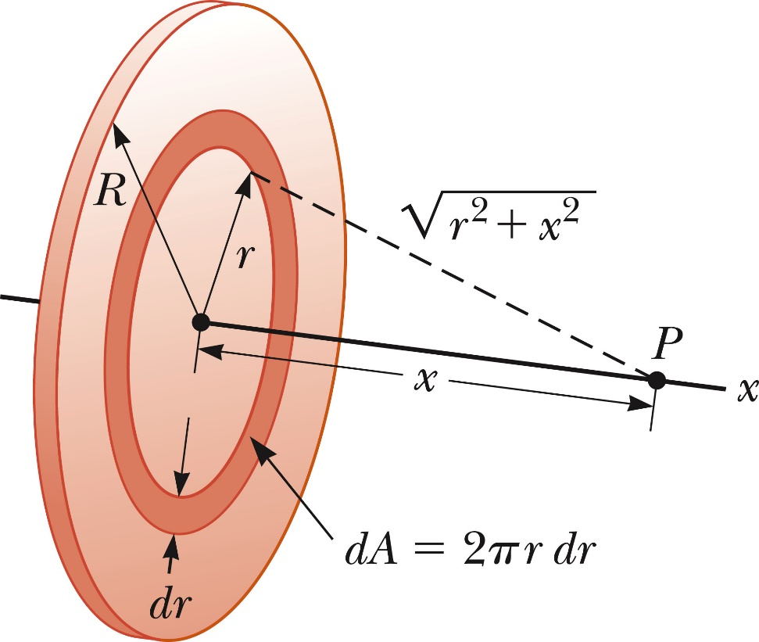

Electric Potential Due to a Uniformly Charged Disk, Example
(From previous slide)
Section 25.5

Slide 40

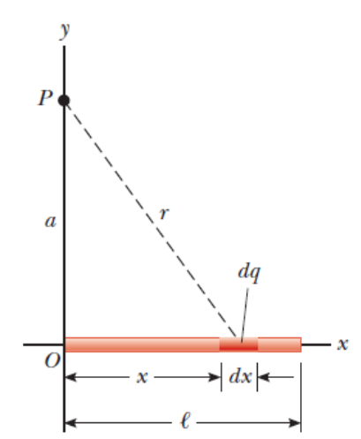
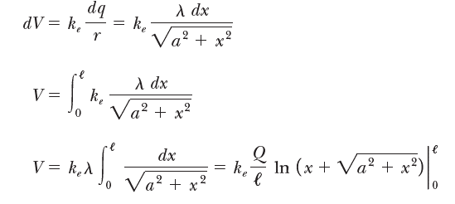

Electric Potential Due to a Finite Line of Charge, Example
PHYS143 – Spring 2017 – © O. Al Khatib
Section 25.5

Slide 41
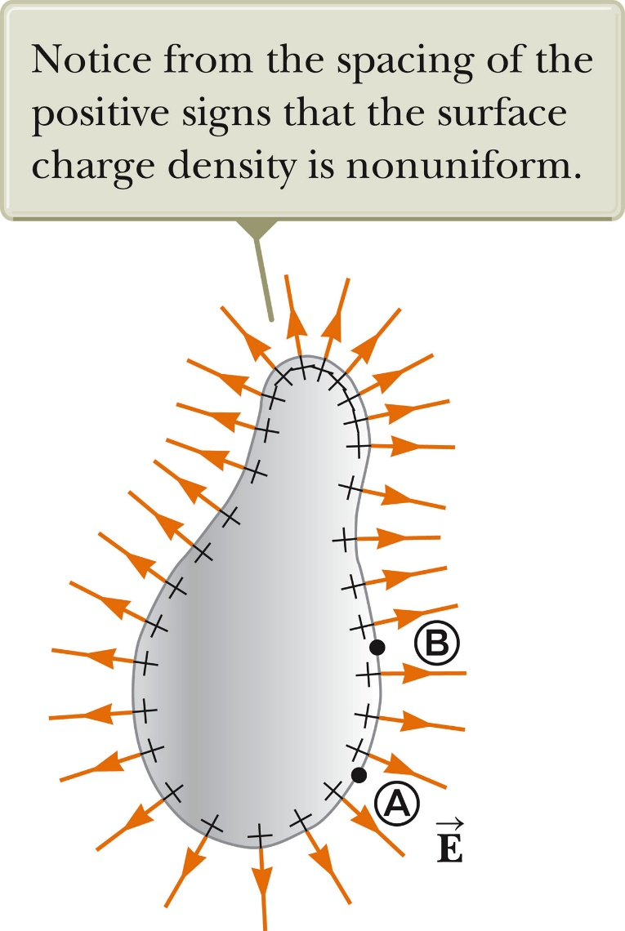


V Due to a Charged Conductor
Consider two points on the surface of the charged conductor as shown.
is always perpendicular to the displacement .
Therefore,
Therefore, the potential difference between A and B is also zero.
Because of the constant value of the potential, no work is required to move a charge from the interior of a charged conductor to its surface.
Section 25.6

Slide 42
V Due to a Charged Conductor, cont.
V is constant everywhere on the surface of a charged conductor in equilibrium.
  ΔV = 0 between any two points on the surface
The surface of any charged conductor in electrostatic equilibrium is an equipotential surface.
Every point on the surface of a charge conductor in equilibrium is at the same electric potential.
Because the electric field is zero inside the conductor, we conclude that the electric potential is constant everywhere inside the conductor and equal to the value at the surface.
Section 25.6

Slide 43
Irregularly Shaped Objects
The charge density is high where the radius of curvature is small.
  And low where the radius of curvature is large
The electric field is large near the convex points having small radii of curvature and reaches very high values at sharp points.
Section 25.6

Slide 44
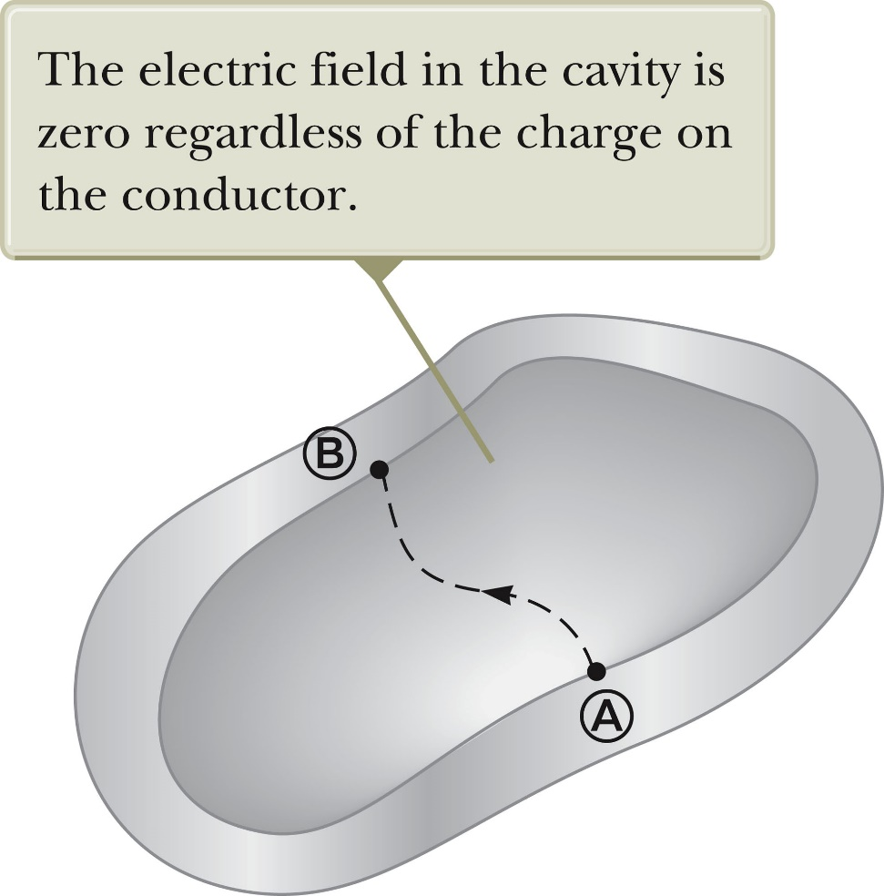
Cavity in a Conductor
Assume an irregularly shaped cavity is inside a conductor.
Assume no charges are inside the cavity.
The electric field inside the conductor must be zero.
Section 25.6

Slide 45
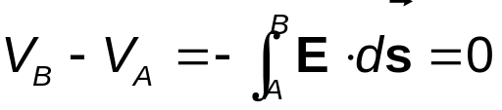
Cavity in a Conductor, cont
The electric field inside does not depend on the charge distribution on the outside surface of the conductor.
For all paths between A and B,
A cavity surrounded by conducting walls is a field-free region as long as no charges are inside the cavity.
Section 25.6

Slide 46
Corona Discharge
If the electric field near a conductor is sufficiently strong, electrons resulting from random ionizations of air molecules near the conductor accelerate away from their parent molecules.
These electrons can ionize additional molecules near the conductor.
This creates more free electrons.
The corona discharge is the glow that results from the recombination of these free electrons with the ionized air molecules.
The ionization and corona discharge are most likely to occur near very sharp points.

